Slide 1

Fake News Detection Using Machine Learning and Deep Learning
Vishnu Vardhan Reddy Bijjam
https://github.com/Vishnu-Bijjam/Capstone_Project_Vishnu

Slide 2
Introduction / Problem Statement
🔍 What Problem Did I Try to Solve?
1. Fake news detection refers to using machine learning algorithms to classify news articles as real or fake, addressing the widespread issue of misinformation on digital platforms
2. Reducing Manual Verification The goal was to automate the news verification process, so fake news can be flagged quickly before it spreads — without depending only on human fact-checkers.
Why Is This Project Important?
Social Impact & Trust: Fake news can influence public opinion, disrupt democratic processes, and incite panic or violence, making reliable detection crucial to maintain societal trust and safety.
Industry Relevance: Social media platforms, news agencies, and cybersecurity firms require automated solutions to moderate content at scale and protect users from disinformation.
Who are the stakeholders or target audience?
Digital Platforms & Media Companies
General Public & Policymakers

Slide 3

Data Collection & Sources
Open-source Repository: The dataset was obtained from Kaggle, a reputable platform for hosting open-source datasets for machine learning projects.
It includes labeled news articles categorized as “FAKE” or “REAL” to support training and testing of classification models.
The dataset contains approximately 10,000 news articles in total, divided between fake and real news.

Slide 4
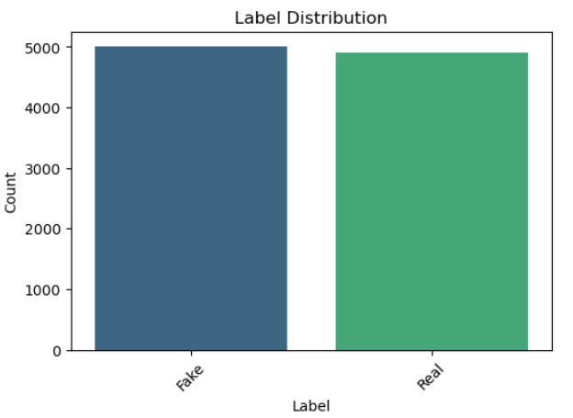
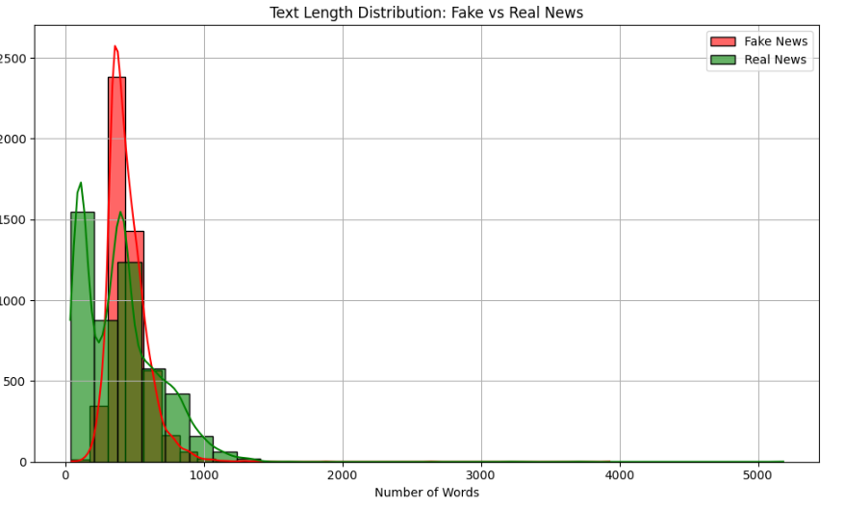
Exploratory Data Analysis (EDA)
Label Distribution Analysis
Text Length Analysis

Slide 5
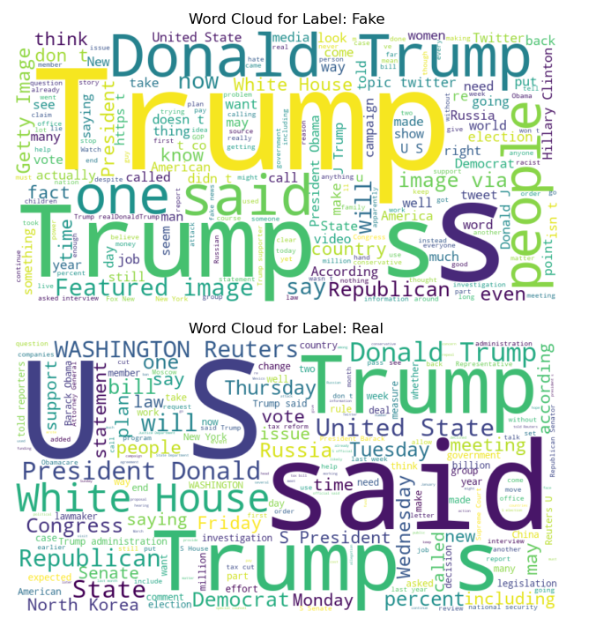
Word Cloud Insights
Fake news articles contain words associated with sensationalism, clickbait, and conspiracy-related terms.
Real news articles use more factual and neutral terminology.

Slide 6
Modeling / Analysis Techniques
TF-IDF (Term Frequency-Inverse Document Frequency) method. It removes common English stop words, ignores very frequent (max_df=0.95) and very rare (min_df=5) terms, and transforms both training and test datasets into TF-IDF representations for use in machine learning models.
I trained data on three ML models such as Linear regression,Random Forest and SVM. All three models demonstrate high accuracy on average 96 % accuracy.
For Deep Learning Models, I used LSTM, which includes preprocessing steps like tokenization, padding, and label encoding, then defines and trains a sequential model using embedding and LSTM layers for binary classification.
For Convolutional Neural Network (CNN), It uses word embeddings and convolutional layers to extract features from text data and predict binary labels.

Slide 7
Results
Key Findings and Model Performance
CNN outperformed traditional ML models, achieving 98.7% accuracy, showcasing its strength in capturing spatial hierarchies in text data even with a simple architecture.
SVM also performed very well with 97.3% accuracy, reflecting strong generalization on vectorized features.
Logistic Regression achieved 96.7% accuracy, proving to be a solid baseline model with high precision and recall for both Fake and Real news classes.
LSTM, on the other hand, underperformed with only 51% accuracy
Interpretation of Results
The CNN model outshined SVM and Logistic Regression, likely due to its ability to extract local features and patterns in text sequences, which is particularly effective when handling short to medium-length text.
Logistic Regression still performed competitively because of its effectiveness with sparse TF-IDF features, especially in well-separated binary classification tasks.
SVM benefited from the linear separation provided by TF-IDF, maintaining strong precision and recall.
LSTM struggled, possibly due to:
Lack of large sequential data.

Slide 8
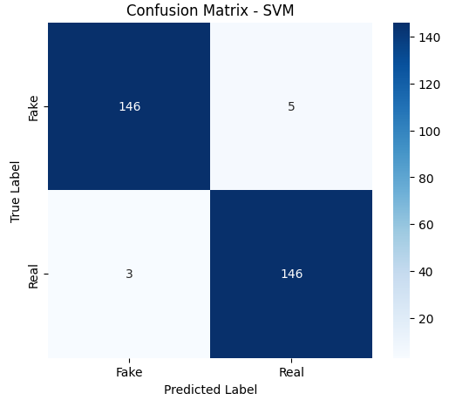
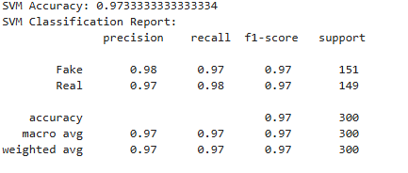
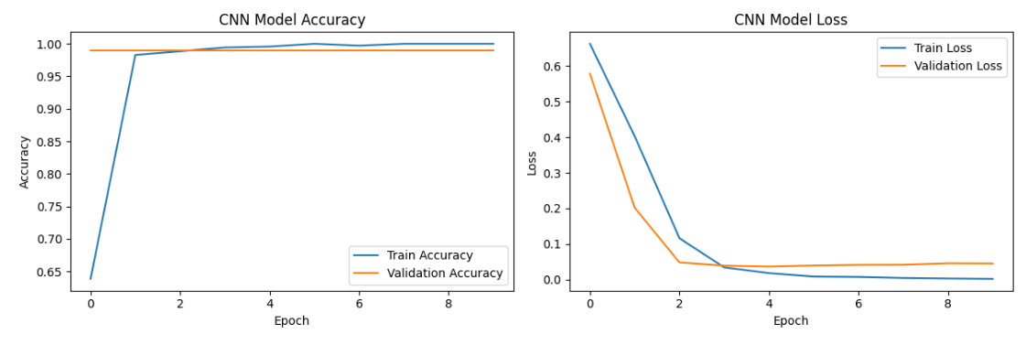

Slide 9
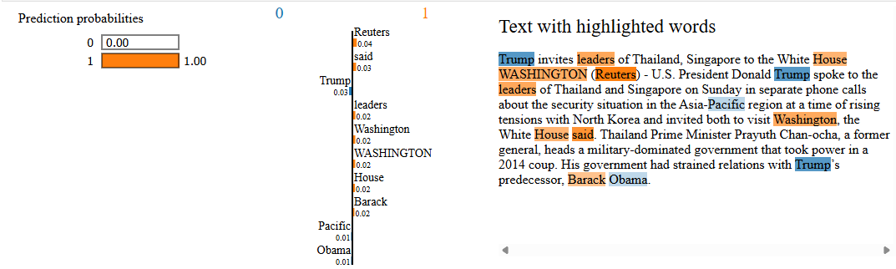
LIME Explanation

Slide 10
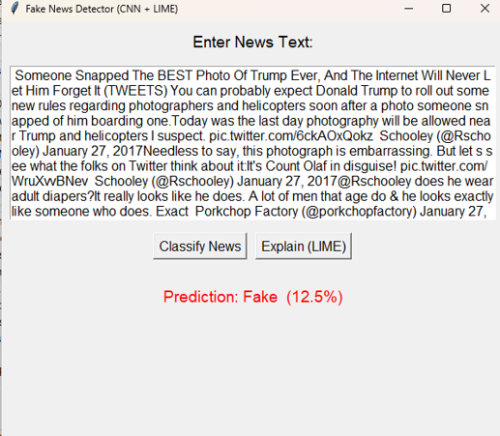
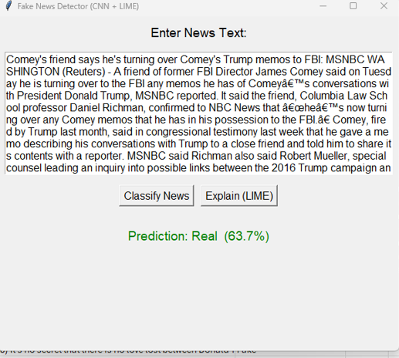
Graphical User Interface(GUI)

Slide 11
Thank you

